Slide 1
CPU Scheduling Lesson 6

Slide 2
BASIC CONCEPTS
Modern computer systems try to achieve maximum CPU utilization. The CPU is the most valuable resource, so the operating system tries very hard to ensure that it is rarely sitting idle. CPU scheduling is the tool that allows this to happen.
CPU scheduling is the basis of multiprogrammed operating systems. By switching the CPU among processes, the operating system can make the computer more productive

Slide 3
BASIC CONCEPTS - Multiprogramming
The objective of multiprogramming is to have some process running at all times, to maximize CPU utilization.
The idea is relatively simple.
A process is executed until it must wait, typically for the completion of some I/O request. In a simple computer system, the CPU then just sits idle. All this waiting time is wasted; no useful work is accomplished.
With multiprogramming, we try to use this time productively. Several processes are kept in memory at one time. When one process has to wait, the operating system takes the CPU away from that process and gives the CPU to another process.
This pattern continues. Every time one process has to wait, another process can take over use of the CPU.

Slide 4
BASIC CONCEPTS - Multiprogramming
On a multicore system, this concept of keeping the CPU busy is extended to all processing cores on the system. Scheduling of this kind is a fundamental operating-system function.
Almost all computer resources are scheduled before use. The CPU is, of course, one of the primary computer resources. Thus, its scheduling is central to operating-system design tries to keep all cores busy.
Why CPU Scheduling Exists
On a single core, only one process (really one kernel thread) can execute at any given instant.
Other processes must wait in a ready queue.
The OS tries to keep the CPU always busy, switching between processes whenever one is unable to continue executing.

Slide 5
CPU – I/O Burst Cycle
The success of CPU scheduling depends on an observed property of processes; that the process is never continuous : process execution consists of a cycle of CPU execution and I/O wait.
Processes alternate between these two states. Process execution begins with a CPU burst. That is followed by an I/O burst, which is followed by another CPU burst, then another I/O burst, and so on. Eventually, the final CPU burst ends with a system request to terminate execution.
CPU Burst is a period of computing; executing instructions, doing calculations, updating memory, etc
I/O Burst is a period where the process waits for an I/O operation such as: Reading a file, Waiting for user input, Accessing network data, Disk operations,
During I/O, the CPU is not used by that process.

Slide 6
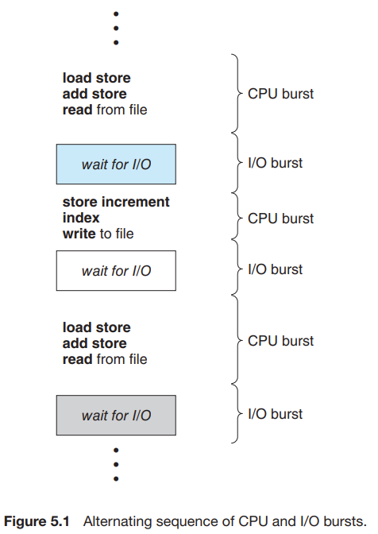
CPU – I/O Burst Cycle
Why This Cycle Matters
CPU-bound processes have long CPU bursts, fewer I/O waits.
I/O-bound processes have many short CPU bursts, frequent waits.
Schedulers use this pattern to decide which processes make better use of the CPU.

Slide 7
CPU Scheduler
Whenever the CPU becomes idle, the operating system must select one of the processes in the ready queue to be executed.
The selection process is carried out by the CPU scheduler, which selects a process from the processes in memory that are ready to execute and allocates the CPU to that process.
Note that the ready queue is not necessarily a first-in, first-out (FIFO) queue.
As we shall see when we consider the various scheduling algorithms, a ready queue can be implemented as a FIFO queue, a priority queue, a tree, or simply an unordered linked list.
Conceptually, however, all the processes in the ready queue are lined up waiting for a chance to run on the CPU.

Slide 8
Preemptive and Nonpreemptive Scheduling
CPU scheduling decisions can happen under exactly four events in the life of a process. Understanding these four situations is the key to understanding preemption, fairness, and the complexity of kernel design.
1. When a process switches from the running state to the waiting state
(Process voluntarily stops using the CPU)
Examples:
It performs an I/O operation (disk, network, keyboard, etc.).
It calls wait() for a child process.
It blocks waiting for some external event.
Here, the process cannot continue executing, so it must leave the CPU. The scheduler has no choice — it must pick another ready process.

Slide 9
Preemptive and Nonpreemptive Scheduling
2. When a process switches from the running state to the ready state
(Process is preempted)
This happens when:
A timer interrupt fires (end of a time slice).
A higher-priority process becomes ready.
An interrupt causes the OS to intervene.
Here, the scheduler has a choice:
Allow the running process to continue, or
Preempt it and schedule another process.
This is where preemptive vs nonpreemptive scheduling diverge.

Slide 10
Preemptive and Nonpreemptive Scheduling
3. When a process switches from the waiting state to the ready state
(Process completes I/O and becomes ready again)
Example:
A disk read finishes.
A network packet arrives.
A user presses a key and the process that was waiting on input becomes ready.
Once again, the scheduler must decide:
Should the newly ready process run immediately?
Should the currently running process keep the CPU?
This is another decision point for preemption.

Slide 11
Preemptive and Nonpreemptive Scheduling
4. . When a process terminates
(Process finishes execution)
Here, the CPU becomes free because a process completed. The scheduler must choose another process from the ready queue.

Slide 12
Preemptive and Nonpreemptive Scheduling
Nonpreemptive (Cooperative) Scheduling
In this scheme, the CPU is given to a process and only taken away when the process willingly gives it up, i.e., only in events:
1. Running to Waiting
4. Termination
This means:
No one can interrupt a running process.
The process “cooperatively” decides when to release the CPU.
Few modern systems use it.

Slide 13
Preemptive and Nonpreemptive Scheduling
Advantages
Simple to implement.
No complex race conditions due to mid-execution preemption.
Kernel design is easier and more stable.
Disadvantages
A misbehaving process can hog the CPU indefinitely.
Poor response time for interactive systems.
Very bad for real-time or multiuser systems.

Slide 14
Preemptive and Nonpreemptive Scheduling
Preemptive Scheduling
Preemptive scheduling allows the OS to interrupt a running process at any of the decision points:
2 Running to Ready
3 Waiting t0 Ready
This means the OS can take the CPU forcibly even if the running process does not want to give it up.
Why modern systems require preemption
Better responsg many processes.
Essential for real-time e time (important for interactive systems).
Fair CPU sharing amonguarantees.
Support for priority-based scheduling.
Windows, Linux, macOS, Android, iOS all use preemptive policies.

Slide 15
Dispatcher
The dispatcher is the comp0nent of the OS that performs the actual context switch and transfers control to the selected process. After the scheduler decides who to run, the dispatcher performs the switch.
Dispatcher Responsibilities
Context Switching Save the state of the old process and restore state of the new one.
Switch to User Mode Since the scheduler and dispatcher run in kernel mode.
Jump to proper location in the new program to resume execution.

Slide 16
Dispatcher
Dispatch Latency
This is the time required for the dispatcher to:
Stop one process,
Save its state,
Restore the new process state,
Start executing it.
Minimizing dispatch latency is essential because context switches occur very frequently.

Slide 17
Scheduling Criteria
Before choosing a CPU scheduling algorithm (like FCFS, SJF, Priority, RR, etc.), we must evaluate how well that algorithm serves the goals of the operating system. Different environments care about different things.
For example:
A batch processing system cares about throughput.
A desktop system cares about response time.
A real-time system cares about meeting deadlines.
A cloud server cares about fairness and CPU utilization.
Therefore, each scheduling algorithm is judged using several important performance metrics.

Slide 18
Scheduling Criteria
The criteria include the following:
CPU utilization. We want to keep the CPU as busy as possible. Conceptually, CPU utilization can range from 0 to 100 percent. In a real system, it should range from 40 percent (for a lightly loaded system) to 90 percent (for a heavily loaded system).
Throughput : (How many processes finish per unit time?) This measures how much work the system is doing.
For long-running, heavy jobs: maybe 1 process every few seconds
For small transactional jobs: maybe tens or hundreds per second

Slide 19
Scheduling Criteria
3. Turnaround Time (“How long does a process take from start to finish?”)
Turnaround time includes:
Turnaround = Waiting in ready queue
+ CPU execution time
+ I/O time
It is the user’s perception of how long their job took overall.
4. Waiting time. The CPU-scheduling algorithm does not affect the amount of time during which a process executes or does I/O. It affects only the amount of time that a process spends waiting in the ready queue.
Waiting time is the sum of the periods spent waiting in the ready queue

Slide 20
Scheduling Criteria
5. Response time. This is the time it takes to start responding, not the time it takes to output the response.
In an interactive system, turnaround time may not be the best criterion. Often, a process can produce some output fairly early and can continue computing new results while previous results are being output to the user. Thus, another measure is the time from the submission of a request until the first response is produced.
Response time = Time from request submission TO first observable response.
This is not the same as turnaround time.
Example:
You click an icon.
The program displays a loading spinner immediately.
But it finishes loading after 3 seconds.
Response time was short (spinner appears quickly), turnaround time was longer.

Slide 21
Scheduling Algorithms
CPU scheduling deals with the problem of deciding which of the processes in the ready queue is to be allocated the CPU’s core. There are many different CPU scheduling algorithms.
In this section, we will describe several of them. Although most modern CPU architectures have multiple processing cores, we describe these scheduling algorithms in the context of only one processing core available.
That is, a single CPU that has a single processing core, thus the system is capable of only running one process at a time

Slide 22
First-Come, First-Served (FCFS) Scheduling
1. What FCFS Is All About
First-Come, First-Served (FCFS) is the oldest, simplest, and most straightforward CPU-scheduling algorithm. It follows the exact idea behind real-world queues:
The first customer to arrive at a bank counter is the first one to be served.
Others wait behind until it is their turn.
In computing terms:
Every process that becomes “ready” is placed at the back of a FIFO (First-In First-Out) queue.
The CPU always takes the process from the front of this queue.
There is no priority, no prediction, and no analysis of burst times. Order of arrival = order of execution.

Slide 23
First-Come, First-Served (FCFS) Scheduling
How FCFS Works in the Operating System
When a process changes state from new → ready, the OS attaches its Process Control Block (PCB) to the tail of the ready queue (FIFO).
When the CPU becomes free:
The OS looks at the front of the queue.
The process at the front is allocated the CPU.
That process runs to completion of its CPU burst unless:
It finishes entirely, or
It voluntarily gives up the CPU for I/O.
There is no preemption. Once a process begins its CPU burst, nothing interrupts it—not even a shorter job arriving later.
This is why FCFS is easy to implement but sometimes performs poorly.

Slide 24
First-Come, First-Served (FCFS) Scheduling
Why FCFS Is Simple but Problematic
Although FCFS is conceptually clean, it suffers from two major weaknesses:
(A) Highly Variable Waiting Times
Two different arrival orders can produce dramatically different results. FCFS does not consider:
The duration of each burst (“job length”),
The urgency of processes,
The number of I/O vs CPU bursts.
Because processes run strictly in arrival order, long jobs block shorter ones.

Slide 25
First-Come, First-Served (FCFS) Scheduling
B) Convoy Effect
If one process is very long (CPU-bound) and others are short (I/O-bound), a “traffic jam” effect happens:
The long job gets the CPU and occupies it for a long time.
Short I/O-bound processes finish I/O quickly and pile up in the ready queue, waiting behind the long job.
While waiting, their I/O devices sit idle, wasting resources.
When the long job finally leaves the CPU, all the short jobs rush through quickly.
Then the CPU becomes idle again while those processes return to I/O.
The resources keep alternating between idle CPU and idle I/O devices → poor system utilization.

Slide 26
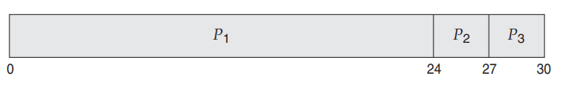
First-Come, First-Served (FCFS) Scheduling
Process Burst Time
P1 24
P2 3
P3 3
If the processes arrive in the order P1, P2, P3, and are served in FCFS order, we get the result shown in the following Gantt chart, which is a bar chart that illustrates a particular schedule, including the start and finish times of each of the participating processes:

Slide 27

First-Come, First-Served (FCFS) Scheduling
Waiting Times:
P1 waits 0 ms.
P2 waits 24 ms (because P1 blocked it).
P3 waits 27 ms (P1 + P2 combined).
Average waiting time:
$$\frac{0+24+27}{3}=17 \text{ms}$$

Slide 28
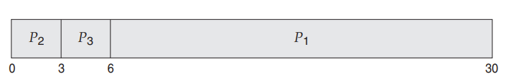
First-Come, First-Served (FCFS) Scheduling
If the processes arrive in the order P2, P3, P1, however, the results will be as shown in the following Gantt chart:
The average waiting time is now (6 + 0 + 3)/3 = 3 milliseconds. Notice the dramatic improvement (17 ms to 3 ms) simply by changing arrival order! FCFS performance is extremely sensitive to the order in which jobs appear.

Slide 29
First-Come, First-Served (FCFS) Scheduling
Note also that the FCFS scheduling algorithm is nonpreemptive. Once the CPU has been allocated to a process, that process keeps the CPU until it releases the CPU, either by terminating or by requesting I/O.
The FCFS algorithm is thus particularly troublesome for interactive systems, where it is important that each process get a share of the CPU at regular intervals. It would be disastrous to allow one process to keep the CPU for an extended period.
Because FCFS is nonpreemptive, it cannot interrupt a long-running process to briefly serve a short one that needs quick attention.
Modern systems never use pure FCFS for scheduling interactive tasks. It is only useful in specific environments like:
Batch processing,
Systems with predictable job lengths,
Simple embedded systems

Slide 30
THANK YOU

